Slide 1
sample superstore project
File created on: 6/14/2022 12:25:43 PM

Slide 2


Slide 3
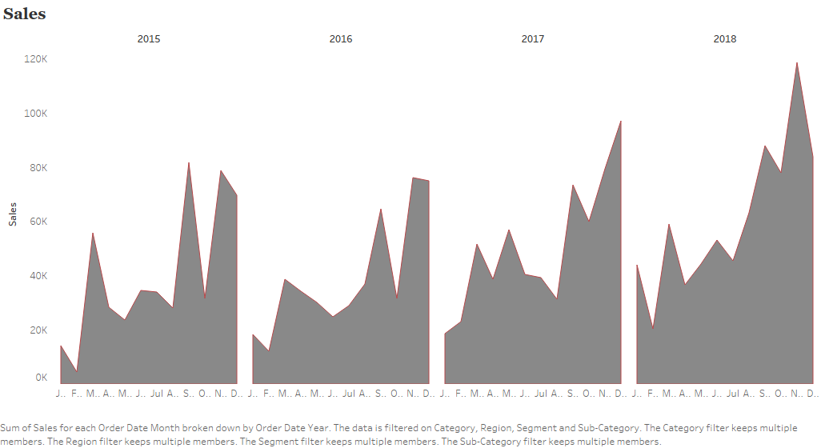

Slide 4
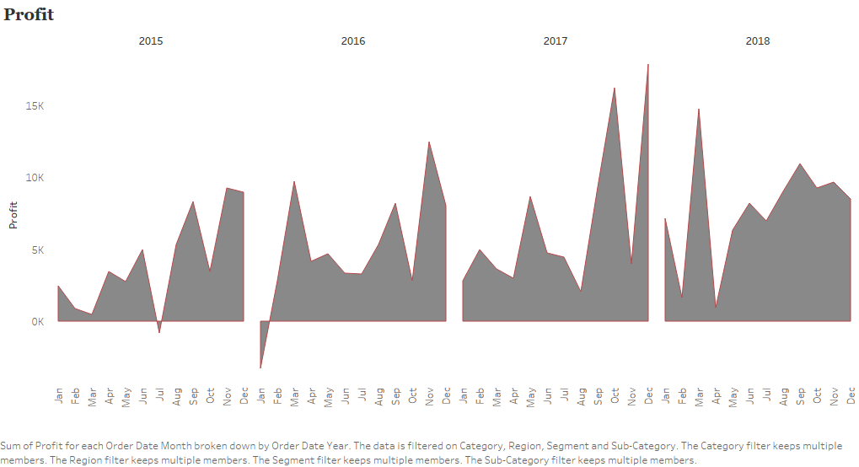

Slide 5
